Slide 1
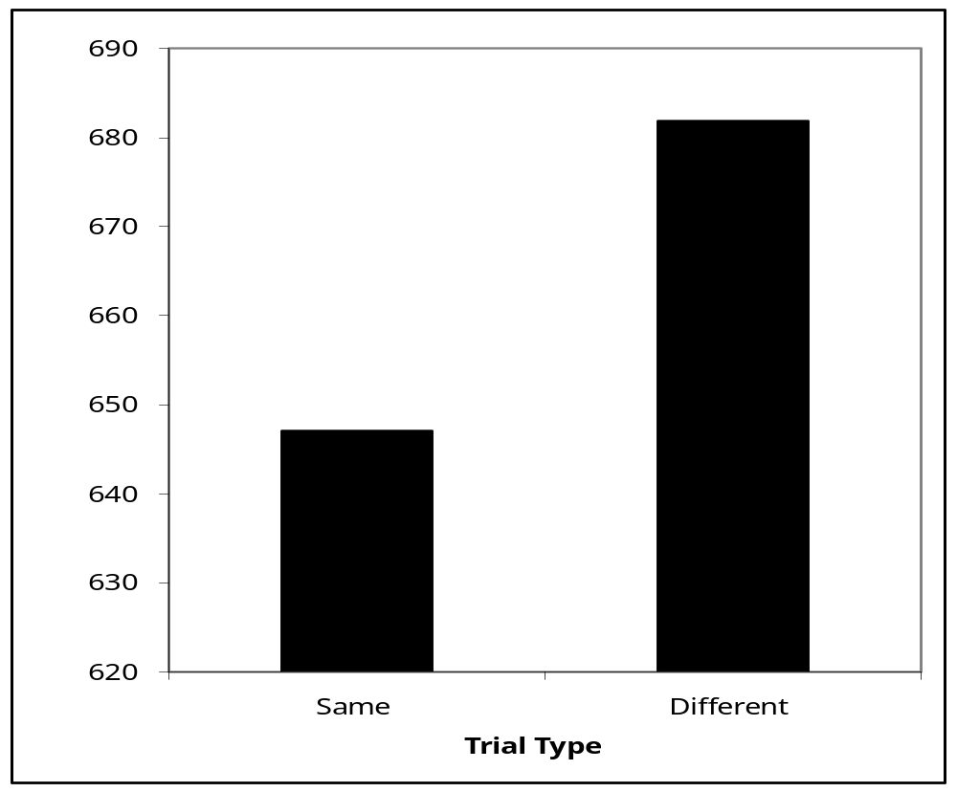
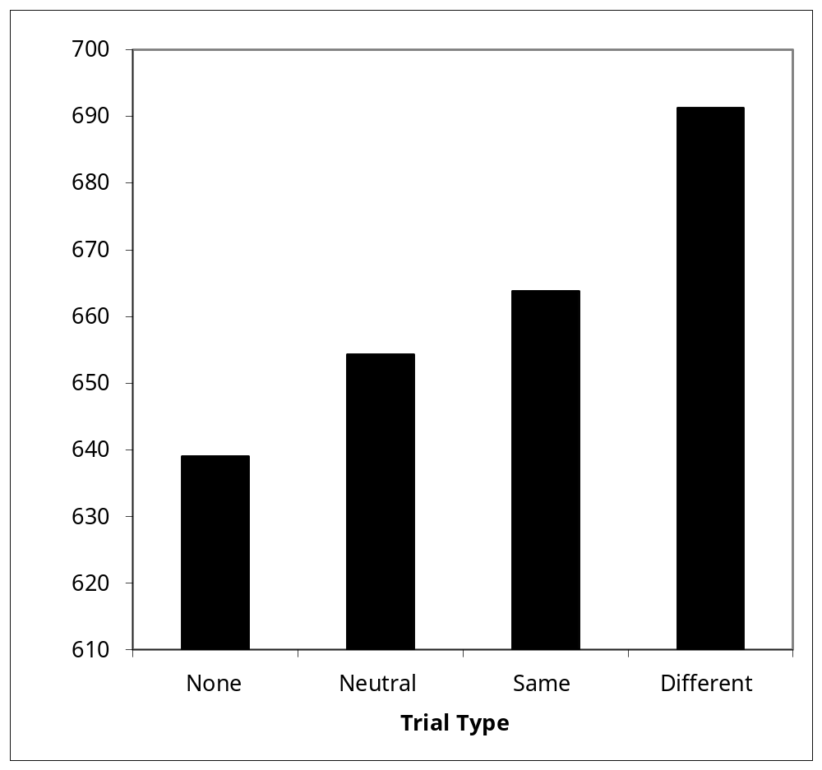
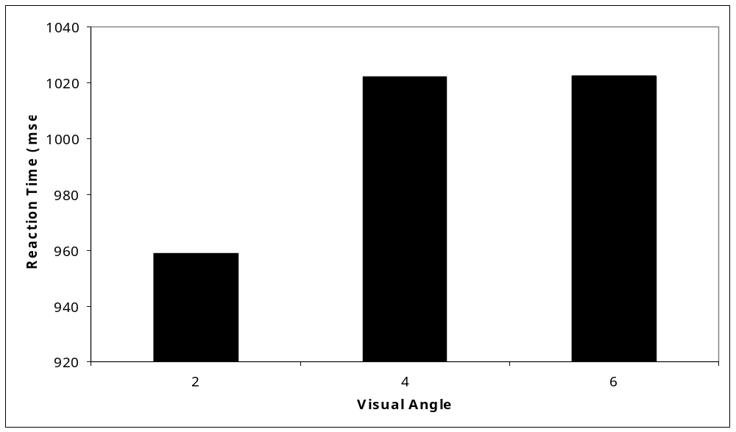

Attention Switching: What’s in the Middle?
Erin Buchanan and M. Kathryn Bleckley
Texas Tech University
Abstract
Attention switching can be defined as moving the focus of attention from one object or task to another object or task. Switching theories are Poser’s spotlight theory (1980), zoom lens or gradient theories (Murphy & Eriksen, 1987; LaBerge & Brown, 1989), and attention shift theories (Sagi & Julesz, 1984). The purpose of this experiment is to test these various attention-switching theories to see if they can be differentiated.
This study looked at a replication of Kwak et al (1991). It tested subjects with a same different matching task with rotated Ts and Ls. Attention switching was hindered by different distractors, indicating the object was scanned as attention moved. However, this was not completely a pop out effect because other distractors (either neutral or helpful distractors) did not have an effect on reaction time for same different decisions.
Same - Different Analysis
L
T
T
T
Discussion
Hypothesis 1
- Time independent shifts were not found. 2º are judged faster than both 4º, 6º of visual angle. Kwak et al’s (1991) time independent shifts of attention or “jumping attention” was not supported.
Hypothesis 2
- Same trials are judge faster than different trials.
- No distractor, neutral distractor, and same distractor trials were all judged at the same speed. All 3 trial types were significantly different than different distractor trial type.
- There was no facilitation effect of helpful distractors.
These findings do not seem to support the spotlight model because it assumes that all distractors would be seen, and there should have been some effect of other distractor types.
Experiment 2 (currently under data collection) replicates a LaBerge & Brown gradient theory experiment, which the same types of distractors to see if their theory more accurately describes attention switching.
T
No Distractor Display
Same Display
Hypotheses
There will be time independent shifts of attention.
Performance will be affected by objects that occur between shifts of attention.
L
O
T
T
L
T
Same trials are judged faster than different trials.
Neutral Display
Different Display
References
Kwak, H., Dagenbach, D., & Egeth, H. (1991). Further evidence
for a time-independent shift of the focus of attention.
Perception & Psychophysics, 49(5), 473-480.
LaBerge, D., & Brown, V. (1989). Theory of attentional
operations in shape identification. Psychological Review,
96(1), 101-124.
Murphy, T., & Eriksen, C. (1987). Temporal changes in the
distribution of attention in the visual field in response to
precues. Perception & Psychophysics, 42(6), 576-586.
Posner, M., Snyder, C., & Davidson, B. (1980). Attention and
the detection of signals. Journal of Experimental Psychology:
General, 109(2), 160-174.
Sagi, D., & Julesz, B. (1984). Detection versus discrimination of
visual orientation. Perception, 13(5), 619-628.
Methods
Participants
55 undergraduates at Texas Tech University
Reported normal vision to corrected normal vision
Apparatus
Replication of Kwak et al (1991), with extra stimuli
15-in CRT (60mHz) monitor controlled by an IBM (Pentium 3) computer
Displays
Rotations were 0 º, 90 º, 180 º, and 270 º
Target Letters were always T or Ls in black
Distractor letters were O, T, L in gray
Target letters were presented at 2 º, 4 º, and 6 º of visual angle
Procedure
Same or Different Task
Participants were told the experiment was not working correctly
Reaction times for same/different responses were recorded
Results
Trial Type Analysis
Kwak Analysis
*
*
Reaction times for 2, 4, 6 degrees of visual angle.
Shifts between 2 degrees of visual angle were significantly
faster than 4 and 6 degree shifts.

